Slide 1
Email

Slide 2
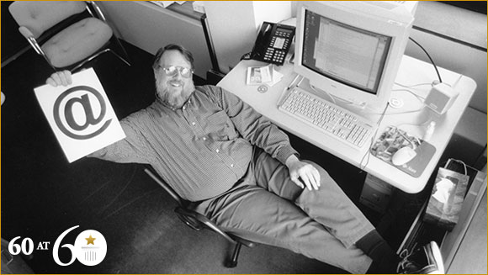
Incridible
Ray Tomlinson to thank for initiating the incredible new era of communication that we now enjoy – he sent the First email in 1971.

Slide 3
Born in New York, USA, in 1941, Tomlinson attended America’s oldest research university, Rensselaer Polytechnic Institute
He received a Bachelor of Science degree in electrical engineering at the age of 22.
He continued his studies at the Massachusetts Institute of Technology (MIT) and earned himself an S.M. in electrical engineering in 1965.

Slide 4
He started his impressive working career as a computer engineer for Bolt, Beranek and Newman (BBN Technologies).
This was the company hired by the United States Defence Department to build ARPANET (Advanced Research Projects Agency Network) – a government-funded network that connected various research organisations across the country: the forerunner of the internet. Tomlinson played a key part in ARPANET’s development.

Slide 5
The invention of email was something that Tomlinson was working on as a personal side project to his commissioned work.
The concept of sending another person a message through a computer was not invented by Tomlinson because computer scientists had been exchanging messages on machines for years.

Slide 6
Tomlinson wanted to send messages to people, not mailboxes, so he decided to modify and combine the programmes that were already out there.
The innovative email software he created was called “SNDMSG”.
It was Tomlinson who decided to use the now-ubiquitous “@” symbol to separate the recipient’s name from their location – to indicate that the user was “at” some other host rather than being local.
As much as the format of emailing has changed over the past 44 years, “user@host” remains the standard for email addresses.

Slide 7
What Tomlinson didn’t invent was the universally-used term “email” (which is an abbreviation of “electronic mail”). This term wasn’t coined until several years later.
Tomlinson also played a large role in developing the first email standards.
He became a co-author of RFC-561 in 1973. This defined several of the email fields we still use today (e.g. From, Subject, and Date).

Slide 8
E-mail
Widely used services on the Internet
Main types
Web-based e-mail
Client-based e-mail
E-mail programs include:
Folders for organization
Address books and distribution groups
Spell checkers
Delivery notification

Slide 9
Reference
Rachel Swatman, 2015, First Ever Email,
[Online] https://www.guinnessworldrecords.com/news/60at60/2015/8/1971-first-ever-email-392973?fb_comment_id=911794135560930_1810110339062634

